Slide 1




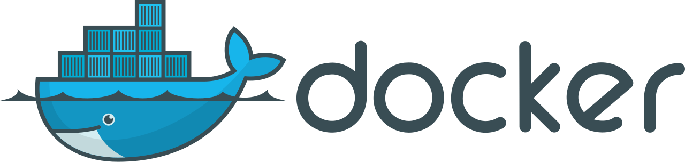
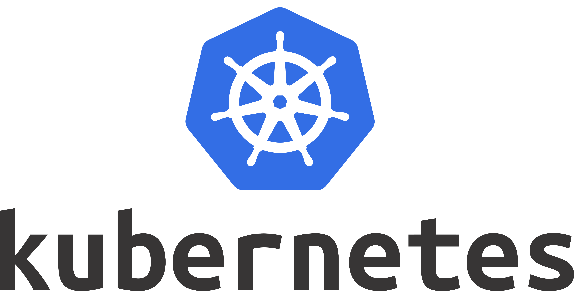

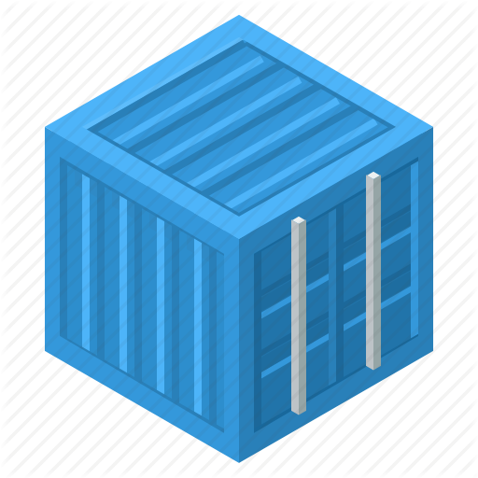




Future of the platform

Slide 2
Topics
Things to consider
Architecture Driving points
Basic Architecture
Backend - Php
Frontend - Javascript
Databases
Caching
Docker
Kubernetes
CI | CD | CD
Overall Architecture Family (Logos)

Slide 3



Things to consider
Security
Cost
Reliability / Consistency
Scalability
Maintainabilty
High Availability
Performance
Standards / Compliance
User Experience
Recovery / Disaster Recovery

Slide 4


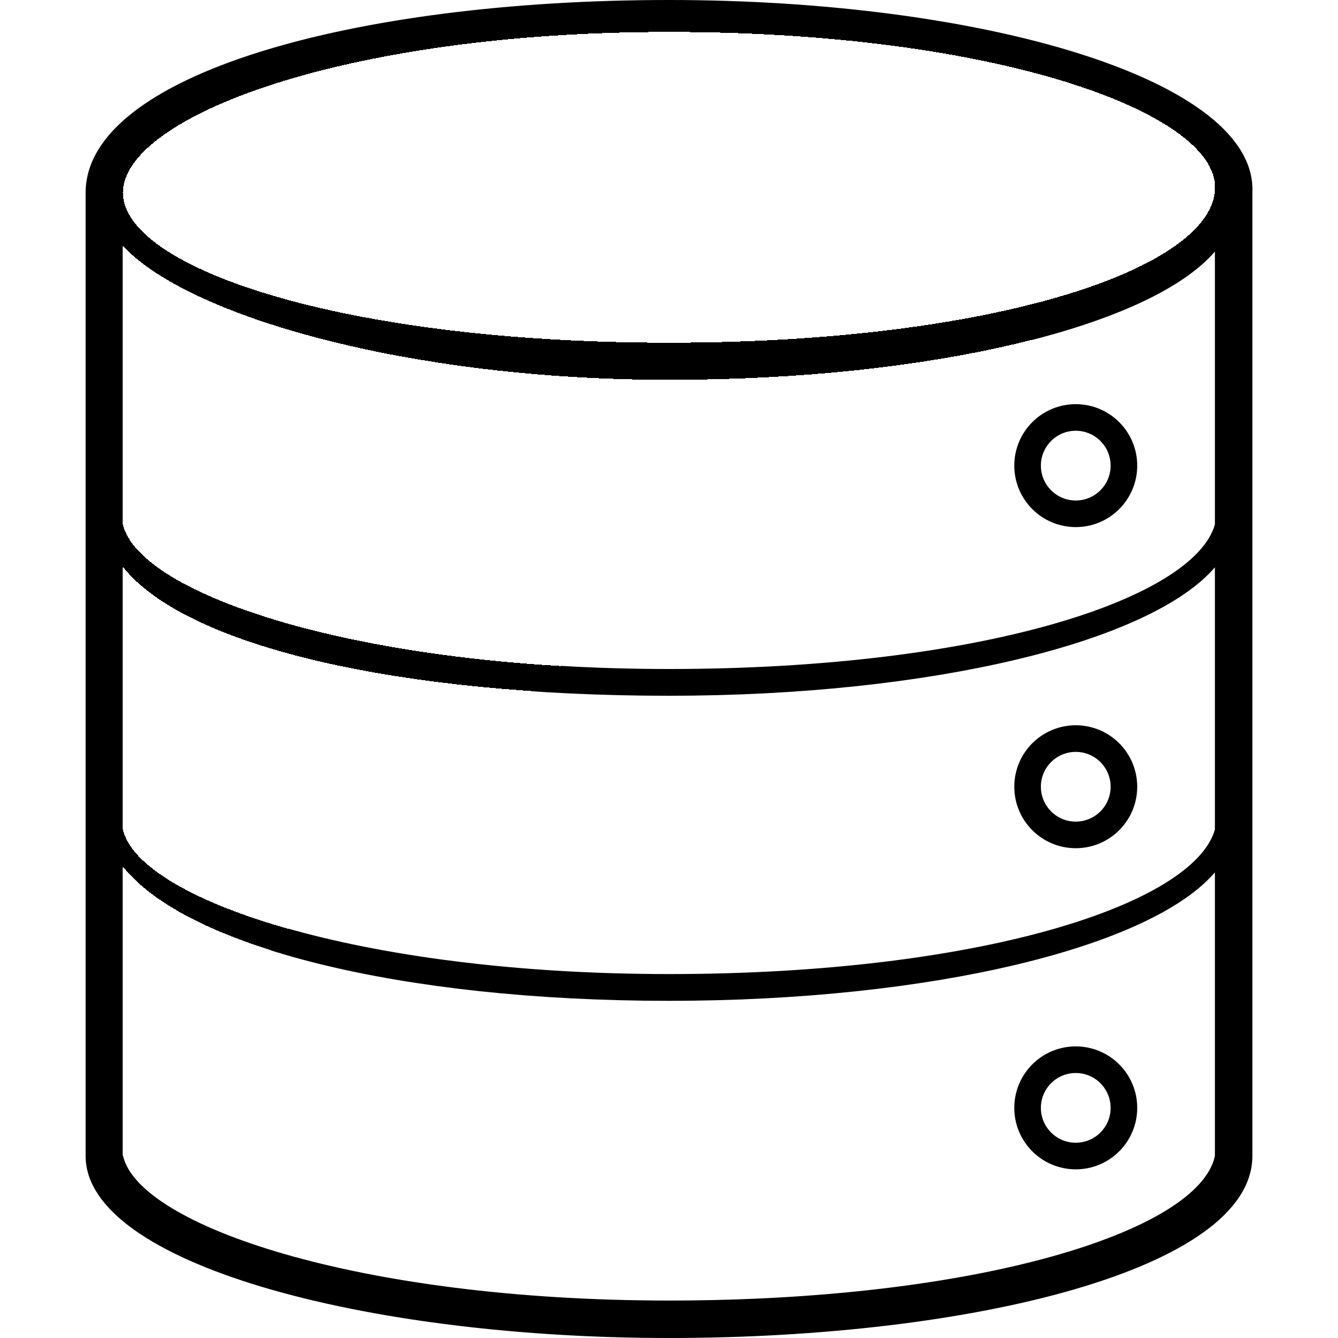
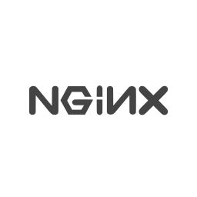


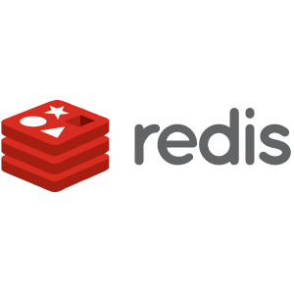

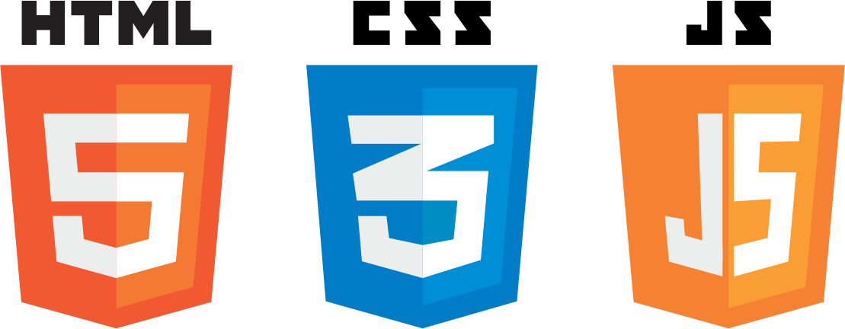








Slide 5
NGINX performs 2.5 times faster than Apache according to a benchmark test running up to 1,000 simultaneous connections. Another benchmark running with 512 simultaneous connections, showed that NGINX is about twice as fast and consumed slightly less memory (4%)
At first, people mostly used Nginx as an Apache supplement. Today, Nginx is often used as a reverse proxy, load balancer, mail proxy and for HTTP caching.
In current time, Laravel & Symfony are php’s 2 top framework. Both are my favorite.
Laravel attempts to take the pain out of development by easing common tasks used in the majority of web projects, such as authentication, routing, sessions, and caching. Laravel aims to make the development process a pleasing one for the developer without sacrificing application functionality.
Symfony: Quickly adopted by professionals active in this field following its launch in 2005, Symfony today is a stable environment that is both well-known and recognized internationally. The number of its references attests to this, as they have grown significantly since its launch. Symfony is also an active community; developers, integrators, users and other contributors who participate in the on-going enrichment of this tool.
If we are thinking anything away from Laravel or Symfony, I would recommend Yii.
Yii is a generic Web programming framework that can be used for developing virtually any type of Web application. Because it is light-weight and equipped with sophisticated caching mechanisms, it is especially suited to high-traffic applications, such as portals, forums, content management systems (CMS), e-commerce systems, etc.
Why Lumen or Slim? Beacuse they are microframeworks.
Lumen is a PHP micro-framework built to deliver microservices and blazing fast APIs.
Slim is one of the most popular PHP microframeworks

Slide 6
React has the slogan: “Learn Once, Write Anywhere.” Software Engineers can use React to develop Web (React), Mobile App (React Native), Desktop App (Electron), and Back-end Development (with Node.js).

Slide 7
SQL | NoSQL | Language - NoSQL
Databases are relational | Databases are non relational | Structure - SQL
Use structured query language and have a predefined schema | Databases have dynamic schemas for unstructured data | Structure - SQL
Vertically scalable - which means that you can increase the load on a single server by increasing things like CPU, RAM or SSD | Horizontally scalable - means that you handle more traffic by sharding, or adding more servers in your NoSQL database | Scalabilty - NoSQL Big Data - NoSQL
Databases are table based. PostgreSQL, MySQL | Databases are document (Elastisearch) , key-value (Redis, Memcahce), graph or wide-column stores. | Fast (Read/Write on Single Entity) - NoSQL
Databases are better for multi-row transactions. Can be used for complex queries | NoSQL are better for unstructured data like documents or JSON. Not good for complex queries | Complex Queries - SQL
ACID Compliant | Most NoSql compromise ACID properties | ACID - SQL

Slide 8


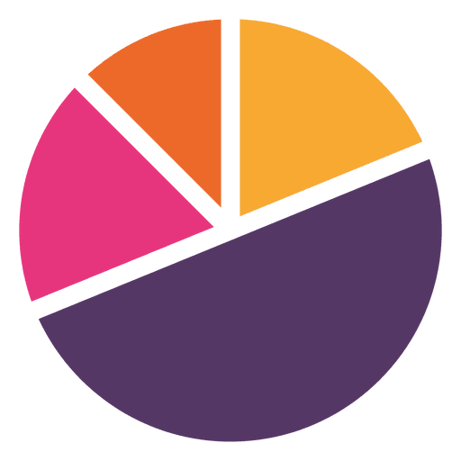
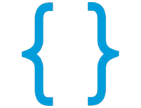
Open source analytics & full text search engine
Query & analyze structured data
Data stored as documents - Simlilar to a row in realtional database (eg MySQL)
Field values
Quering Elasticsearch
“firstname”: “Uday”,
“lastname”: “Karkera”,
Request
“interests”: [“Logstash”, “Kibana”, “Elastic Stack”],
Fields
Client
REST API
Easy to use, and highly scalable

Slide 9


Earlier, data to be stored in a relational database
Such databases are not so great at full-text searches
Now, data will be stored both in DB and Elasticsearch.
Storing data both places wont sound a good idea.
But with Elasticsearch its a best approach & will make a lot sense.
Kibana - a web interface. It interacts with Elasticsearch. Run it on a machine of our choice. Configure it to connect to Elasticsearch.
Send events via web server to Logstash.
Logstash will process events & send them
to Elasticsearch. Event processing will be
centralized with LS.
In a perfect world, our web application will be
only be quering Elasticsearch not modifying data.

Slide 10

HTTP Request
Cached Response
Cache Miss
Server Response
Why Varnish Cache?
Focuses on reducing the number of requests served by your Web server
It delivers content via high-speed caching of web pages
Caches all resources – Webpages, Images, Styles, Scripts and more
Minimizes the time taken for delivering content from your Cloud Hosting Server to the User
Understanding Varnish Cache
Works on key-value principle.
It associates large chunks of data with a key
This key is used to fetch data for a request.
Note
Does not cache HTTP POST requests, authorization headers and cookies
Primarily caches HTTP GET and HEAD requests
Offers a high level of customizations with the use of VCL (Varnish Configuration Language)

Slide 11
Redis
Read
Replica
App
Redis
Master
Cache Updates
App Reads
Db Reads
Db Writes
Redis is a NoSQL database which follows the principle of key-value store.
Speed: Redis stores the whole dataset in primary memory that's why it is extremely fast.
Sharding: Redis supports sharding. It is very easy to distribute the dataset across multiple Redis instances, like other key-value store.
Master/Slave Replication: Redis follows a very simple and fast Master/Slave replication.

Slide 12
Redis vs Others
APC - This option can be considered as the fastest one when dealing with cache for a centralized thick application (e.g. one server, no dedicated load balancers, etc.).
Memcahce - This option can be considered as the fastest one when dealing with cache in a distributed applications (e.g. with several servers, load balancers, etc.)
Redis and memcache are more or less interchangeable. Redis is considered the newer/faster option but real world performance hasn’t always reflected that sentiment.
The performance and memory usage of Redis compared to memcached is relatively similar. Unless you already have a large investment in memcached, going forward redis is the obvious solution. Not only Redis is better option, it enables whole new types of use cases and usage patterns.
Redis use case:
Redis is a NoSQL key-value data store.
Persistence: While all the data lives in memory, changes are asynchronously saved on disk using flexible policies based on elapsed time and/or number of updates since last save. Redis supports an append-only file persistence mode.
Data Structures: Redis supports various types of data structures such as strings, hashes, sets, lists, sorted sets with range queries, bitmaps, hyperloglogs and geospatial indexes with radius queries.
Speed: Redis stores the whole dataset in primary memory that's why it is extremely fast.
As a conclusion:
The microservice should include a straight forward setup for Redis: by default it contains database caching.

Slide 13

Docker can containerize applications.
It is a tool designed to make it easier to create, deploy, and run applications by using containers.
Request from Web
Response
Containers allow a developer to package up an application with all of the parts it needs, such as libraries and other dependencies, and ship it all out as one package.

Slide 14
Kubernetes uses docker host to host applications in the form of docker containers.
Kubernetes cluster consists of a set of nodes. A node is usually a machine (physical/virtual) on which kubernetes software/tools are installed. A node is a worker machine and that is where the containers will be launched
MASTER
Node
Node
Node
Node
Master Node with the kubernetes controlled components are installed. Master wathces over the nodes in cluster & is responsible for the actual orchaestration of containers on the worker nodes.

Slide 15
With Kubernetes using the kubernetes cli (kubectl) you can run 1k instances of the same application with a single command. Kubernetes can scale it upto 2k intances with another command. It can handle it automatically, scaling it up and down based on user load.
LB
UI
API Server
API
Scheduler
Controller
CLI
etcd
Master
Node 1
Node 2
Overlay Network

Slide 16
Continuous Integration
BUILDS
TESTS
ACCEPTANCE
TESTS
DEPLOY TO
STAGING
DEPLOY TO
PRODUCTION
SMOKE
TESTS

Slide 17
FE Cahce
CDN, Browser
Cache, Varnish, HTTP Caching
BE Cache
Apc, Memcahce, Redis
API
Php
Laravel
Symfony
Yii
Lumen
Slim
Moodle
Databases
Postgres
MySQL
Redis
Elasticsearch
Security
Owasp
Dos
Ddos
CSRF
XSS
SQL Injection
Error Handling
Tools
Docker
Kubernetes
Taefik
CICD ?
VCS
GIT
Queing
RabbitMQ
Gearman
Web Server
Ngnix
OS
Linux / Ubuntu
Frontend
React
TypeScript

